Slide 1

KNN Means Clustering

Slide 2
Table of Content
Clustering
What is K-Means Cluster
K-Means demonstration through Python using SKLearn Library
Resources

Slide 3
What is Cluster
What Is Clustering?
Clustering is a set of techniques used to partition data into groups, or clusters. Clusters are loosely defined as groups of data objects that are more similar to other objects in their cluster than they are to data objects in other clusters. In practice, clustering helps identify two qualities of data:
Meaningfulness
Usefulness

Slide 4
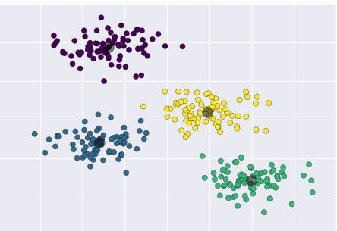
Meaningful clusters expand domain knowledge. For example, in the medical field, researchers applied clustering to gene expression experiments. The clustering results identified groups of patients who respond differently to medical treatments.
Useful clusters, on the other hand, serve as an intermediate step in a data pipeline. For example, businesses use clustering for customer segmentation. The clustering results segment customers into groups with similar purchase histories, which businesses can then use to create targeted advertising campaigns.

Slide 5
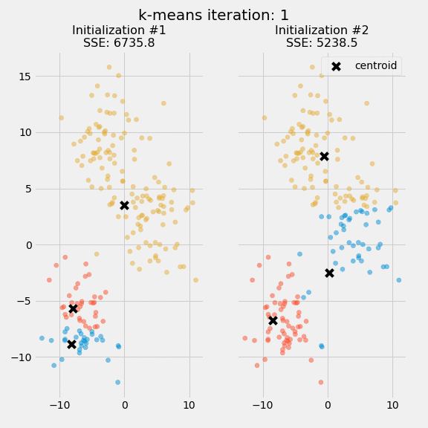
K-Means Clustering
K means divides the data into various clusters and the number of clusters is equal to the value of k i.e. if k=3 then the data will be divided into 3 clusters. each value of k is a centroid around which the data points will gather.

Slide 6
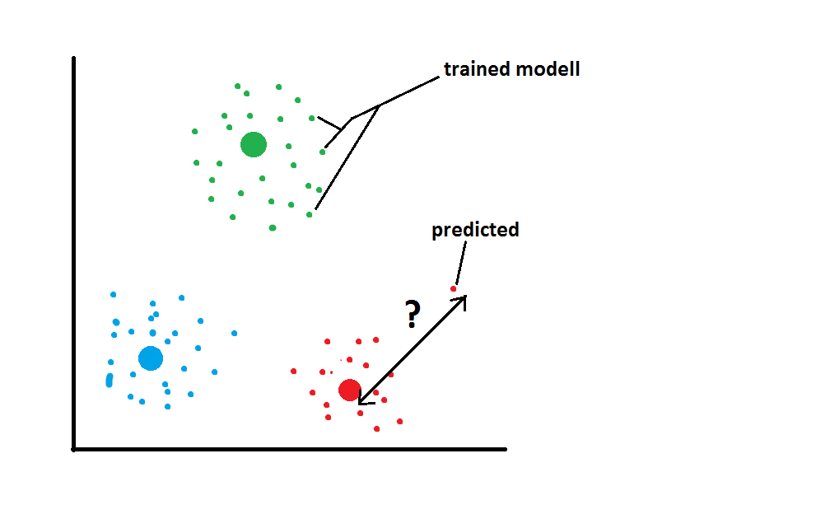
A centroid is a data point (imaginary or real) at the center of a cluster. The resulting classifier is used to classify (using k = 1) the data and thereby produce an initial randomized set of clusters. Each centroid is thereafter set to the arithmetic mean of the cluster it defines.

Slide 7
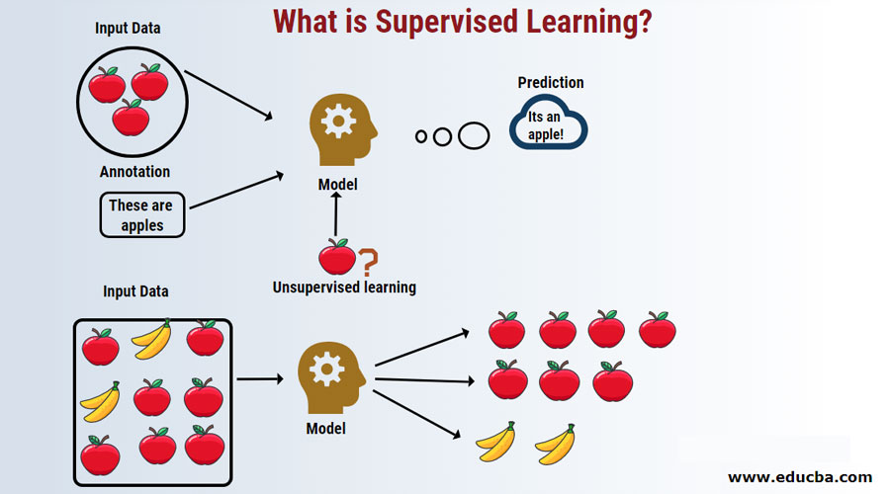
Supervised vs Unsupervised Learning

Slide 8
Definitions & Parameters
The k-means algorithm searches for a pre-determined number of clusters within an unlabeled multidimensional dataset. It accomplishes this using a simple conception of what the optimal clustering looks like:
The "cluster center" is the arithmetic mean of all the points belonging to the cluster.
Each point is closer to its own cluster center than to other cluster centers.
n_initint, default=10: Number of time the k-means algorithm will be run with different centroid seeds. The final results will be the best output of n_init consecutive runs in terms of inertia.
max_iterint, default=300: Maximum number of iterations of the k-means algorithm for a single run.

Slide 9
Definitions & Parameters
random_state (default=None): Determines random number generation for centroid initialization. Use an int to make the randomness deterministic.
Init (default='K-mean++'):: ‘k-means++’ : selects initial cluster centers for k-mean clustering in a smart way to speed up convergence
n_samples is the total number of samples to generate.
centers is the number of centers to generate.
cluster_std is the standard deviation.

Slide 10
K means clustering algorithm steps
Choose a random number of centroids in the data. i.e k=3.
Choose the same number of random points on the 2D canvas as centroids.
Calculate the distance of each data point from the centroids.
Allocate the data point to a cluster where its distance from the centroid is minimum.
Recalculate the new centroids.
Recalculate the distance from each data point to new centroids.
Repeat the steps from point 3, till no data point change its cluster.

Slide 11
Python Code for K-Means #1
from sklearn.cluster import KMeans import numpy as np X = np.array([[1, 2], [1, 4], [1, 0], [10, 2], [10, 4], [10, 0]]) kmeans = KMeans(n_clusters=2)
kmeans.fit(X) kmeans.labels_ kmeans.predict([[0, 0], [12, 3]]) print(kmeans.cluster_centers_)

Slide 12
Python Code for K-Means #2
from sklearn.cluster import KMeans import numpy as np
x1 = 10*np.random.rand(100, 2)
x1.shape
kmean=KMeans(n_clusters=3)
kmean.fit(x1)
Print(kmean.cluster_centers_)

Slide 13
Python Code for K-Means #3
import matplotlib.pyplot as plt
import seaborn as sns; sns.set() # for plot styling
import numpy as np
from sklearn.datasets.samples_generator import make_blobs
X, y_true = make_blobs(n_samples=300, centers=4, cluster_std=0.60, random_state=0)
plt.scatter(X[:, 0], X[:, 1], s=50);

Slide 14
Python Code for K-Means #3
from sklearn.cluster import KMeans
kmeans = KMeans(n_clusters=4)
kmeans.fit(X)
y_kmeans = kmeans.predict(X)
plt.scatter(X[:, 0], X[:, 1], c=y_kmeans, s=50, cmap='viridis')
centers = kmeans.cluster_centers_
plt.scatter(centers[:, 0], centers[:, 1], c='black', s=200, alpha=0.5);

Slide 15
Resources
https://www.youtube.com/watch?v=4b5d3muPQmA
https://realpython.com/k-means-clustering-python/
https://towardsdatascience.com/k-means-clustering-with-python-code-explained-5a792bd19548
https://scikit-learn.org/stable/modules/generated/sklearn.cluster.KMeans.html

